Slide 1
Tedx – Mary Ward
My journey into computer science

Slide 2
Notes:
Good morning faculty and students. My name is Panin Kusi-Achampong and I am a software developer for a company called Fundserv.
Fundserv
Video clip.

Slide 3
What engaged me!
Respect
Power
Money
Hack the Planet!
Notes:
Money, Power, Respect – that’s the key to life!
Hip hop influence.

Slide 4
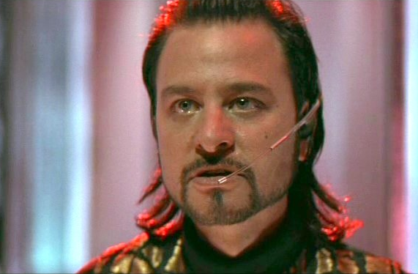
Value the knowledge
The more knowledge you have, the more value have.

Slide 5
Passion
[pash-uh n] - a strong Or extravagant fondness, enthusiasm, or desire for anything

Slide 6
Computers are not my passion!
Computers and specifically software development is the medium by which I am able to get accomplish my passion projects.
Tool/vehicle that allows for me to be mobile in different industry sectors.

Slide 7
Solving problems using software
Solving problems
Helping people
Learning new languages and frameworks
Doing something challenging everyday
Not being tied to any industry
Mobility to work anywhere at anytime
Working with different people anywhere in the world
Being able to work anywhere in the world
Notes:
1. Coming up with new solutions to solve the simplest problems.
2. There are so many opportunities out there to improve on a process or task or an action.
(ie. School attendance)

Slide 8
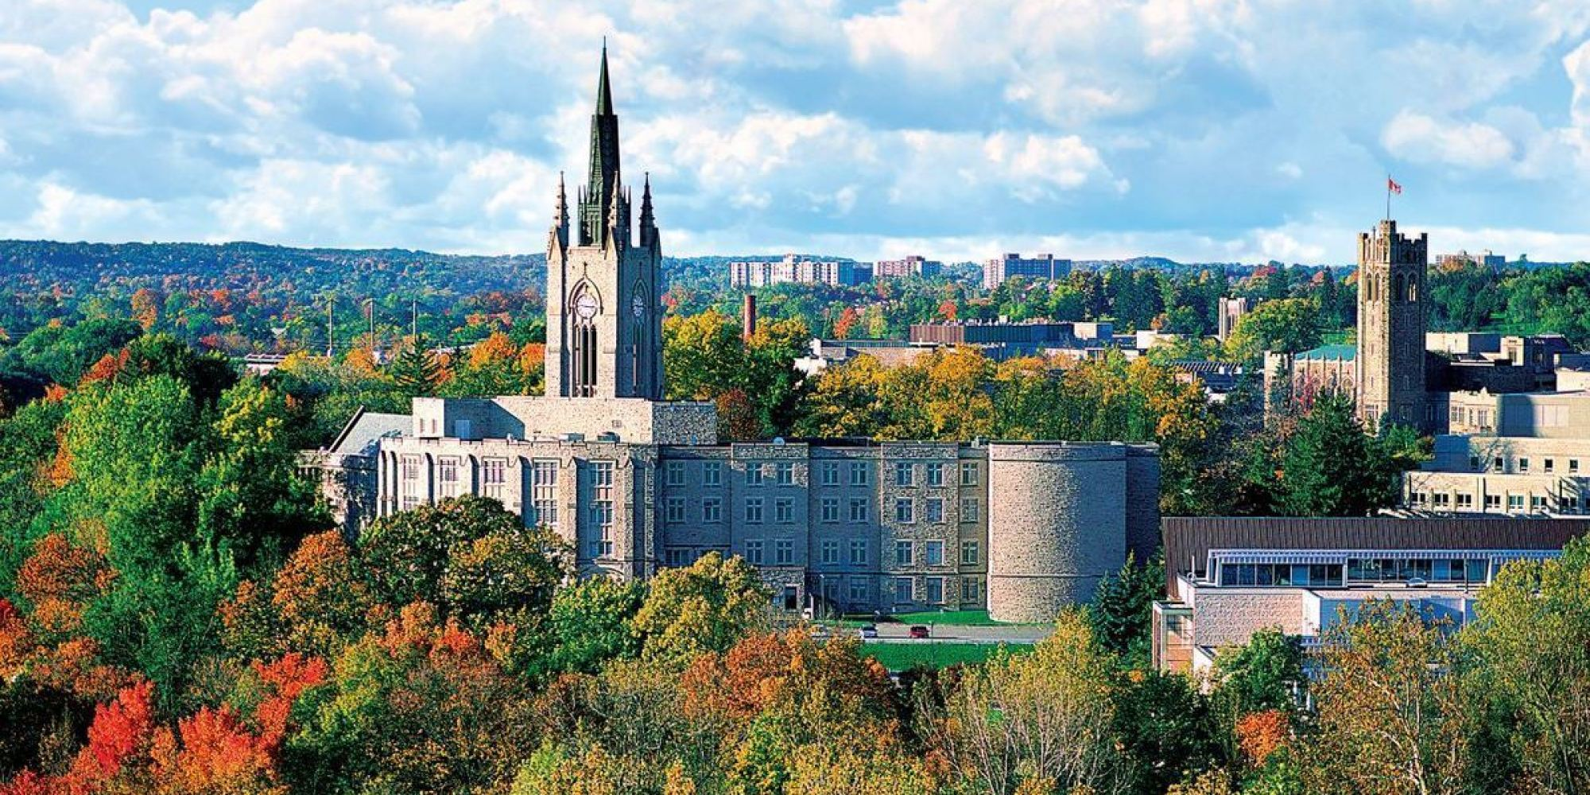
Education

Slide 9
Getting a solid foundation
Math courses came easier so I took those
English
Physics
Philosophy
High school is where you get that foundation.
Notes:
The importance of choosing your courses wisely. (ie. Finite or Data)
Taking more advanced level courses help a lot.
Sometimes though you miss out on an important foundation piece that you don’t know. (ie. Hyperbolas, parabolas)

Slide 10




Notes:
Applying to a university is one of the most daunting tasks ever. You do some research and you pick your top 3 schools. Some of us add a fourth just in case because we’re a little scared of rejection.
What to do when you don’t get your first choice?
How I selected schools – Angie.

Slide 11
Off to Western
What to expect on your educational path…

Slide 12
What to Expect on the journey…
You don’t know nearly as much as you thought you did
Challenging course and course load
Exciting new people and opportunities
There are so many smarter people than you are out there.
Time management and organization are core valuable skills to have
Communicating with everyone from different walks of life.
Find out what you’re made of at the end of it all.

Slide 13

Cups!
First day of programming – define a cup.

Slide 14

Is this a cup too?
Define the properties

Slide 15

How about this?

Slide 16


What about these?

Slide 17


Compare these….

Slide 18

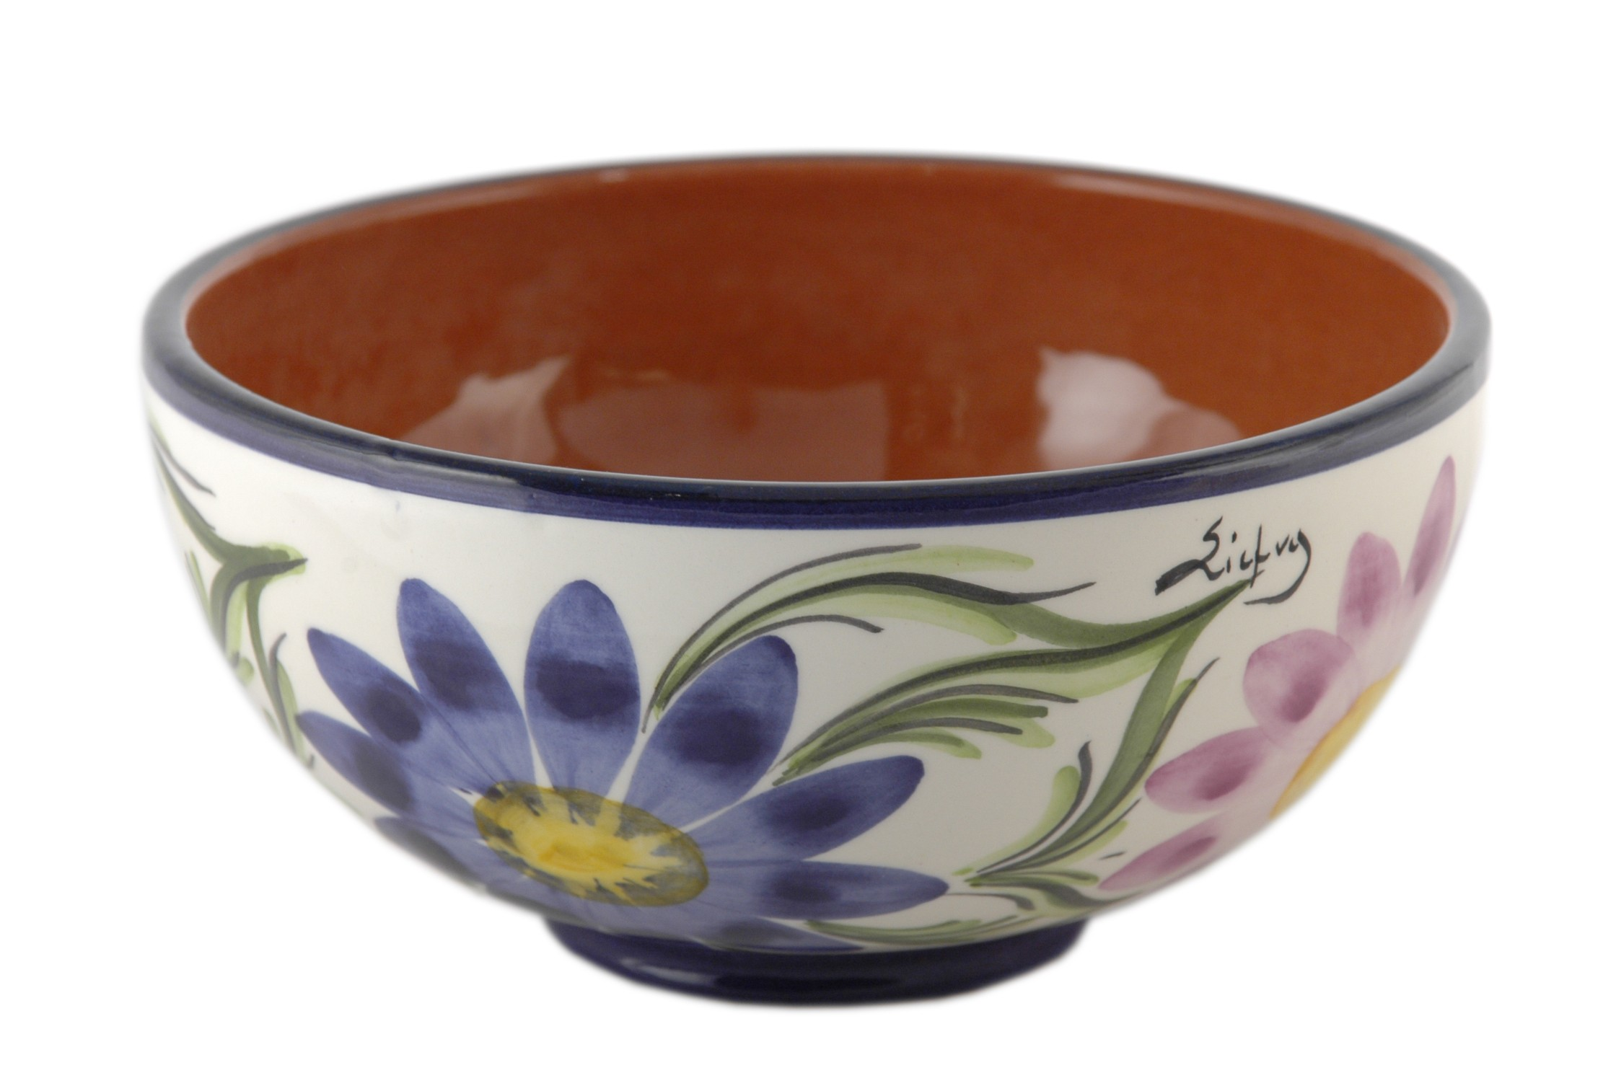
Then come these….

Slide 19
Abstract vs Concrete
Learning the theoretical versus the practical of any and everything.
Transferring that knowledge and understanding to the code you were writing in order to define objects in a way that the unifying and unique properties were enough to accurately capture its essence.

Slide 20
Forget Everything And Run!
Journey away from home solo
Leaving support group
Inner city education – good enough?
Didn’t get into first choice school program

Slide 21
How are you going to succeed?
Support system of teachers, friends and family.
Finding a mentor – someone who has been through what you’re going through. Get the inside scoop.
Find or create a study group.
Join extracurricular student groups – make new friends and network!

Slide 22
What I walked away with…
A degree in Computer Science
An amazing new group of life long friends.
A great network of individuals who can help support me on the next leg of the journey
Stories, memories and experiences that can never be forgotten.
Proven knowledge in my abilities to succeed and overcome difficult situations.

Slide 23
University vs Real World
Returning home
No one automatically gives you a job
Experience is essential
Student loans suck!

Slide 24
Get a Job! Start your career!
Writing resume’s
Prepare for interviews
Work on your soft skills
Volunteer for the experience
Keep learning and stay current
Technology Stacks
Frameworks
But how do I do that?

